Slide 1
Advanced Gameplay Mechanics
Survival
First-third/person
For multiplayer in unreal engine

Slide 2
Table of contents
01
About the project
04
Sneak peek
What’s on the table
Research about metaverse
AV/VR in society
Gameplay Mechanics
02
05
Major requirements
Project stages
research on different time marks milestones
Product comparisons
Product reverse engineering
Unveil of budling stages
Research
Develop
Evolution / Iteration Build
03
06
Matrix
Project goals
Enter the
Said enough!
User-centric mind enabled
Interactive Genre Gameplay Mechanics
Notes:
In section 1 history and general view with more images, 2 more text with less images, 3 specify genre of gameplay mechanics, 4 video presentation, 5 workflow SDLC lifecycle + image of word here, 6 ??? (insert transitions to specific slides e.g., 6) .. Say that project is based and inspired by Advanced Light Actor – Roland Simigla and Horror Engine – tansuergene in Epic Games Unreal Engine Marketplce

Slide 3
Gameplay Mechanics
01
About the project
Research about metaverse
AV/VR in society
Gameplay Mechanics

Slide 4
What are we working on?
Metaverse
AR/VR
Gameplay Mechanics
The future of Internet evolution known as second life is expanding in multiple life software simulations
Hardware Interfaces to interact with the immersive daily life simulated worlds
The software APIs of AR/VR to bridge hardware with software user interaction inside metaverse

Slide 5

About the project
Bridging the gap between hardware and software communication for in-game interaction
Past, Present, Future exploration
Big-tech companies and vision of unified development (common software standards)
Metaverse was already here
Gameplay Mechanics can be characterized as the way to enter the
Matrix

Slide 6
“Consciousness isn’t a journey upward, but a journey inward. Not a pyramid, but a maze.”
—Bernard Lowe, Westworld season one episode 10

Slide 7
Gaming industry rise
Milestone Pandemic

Slide 8
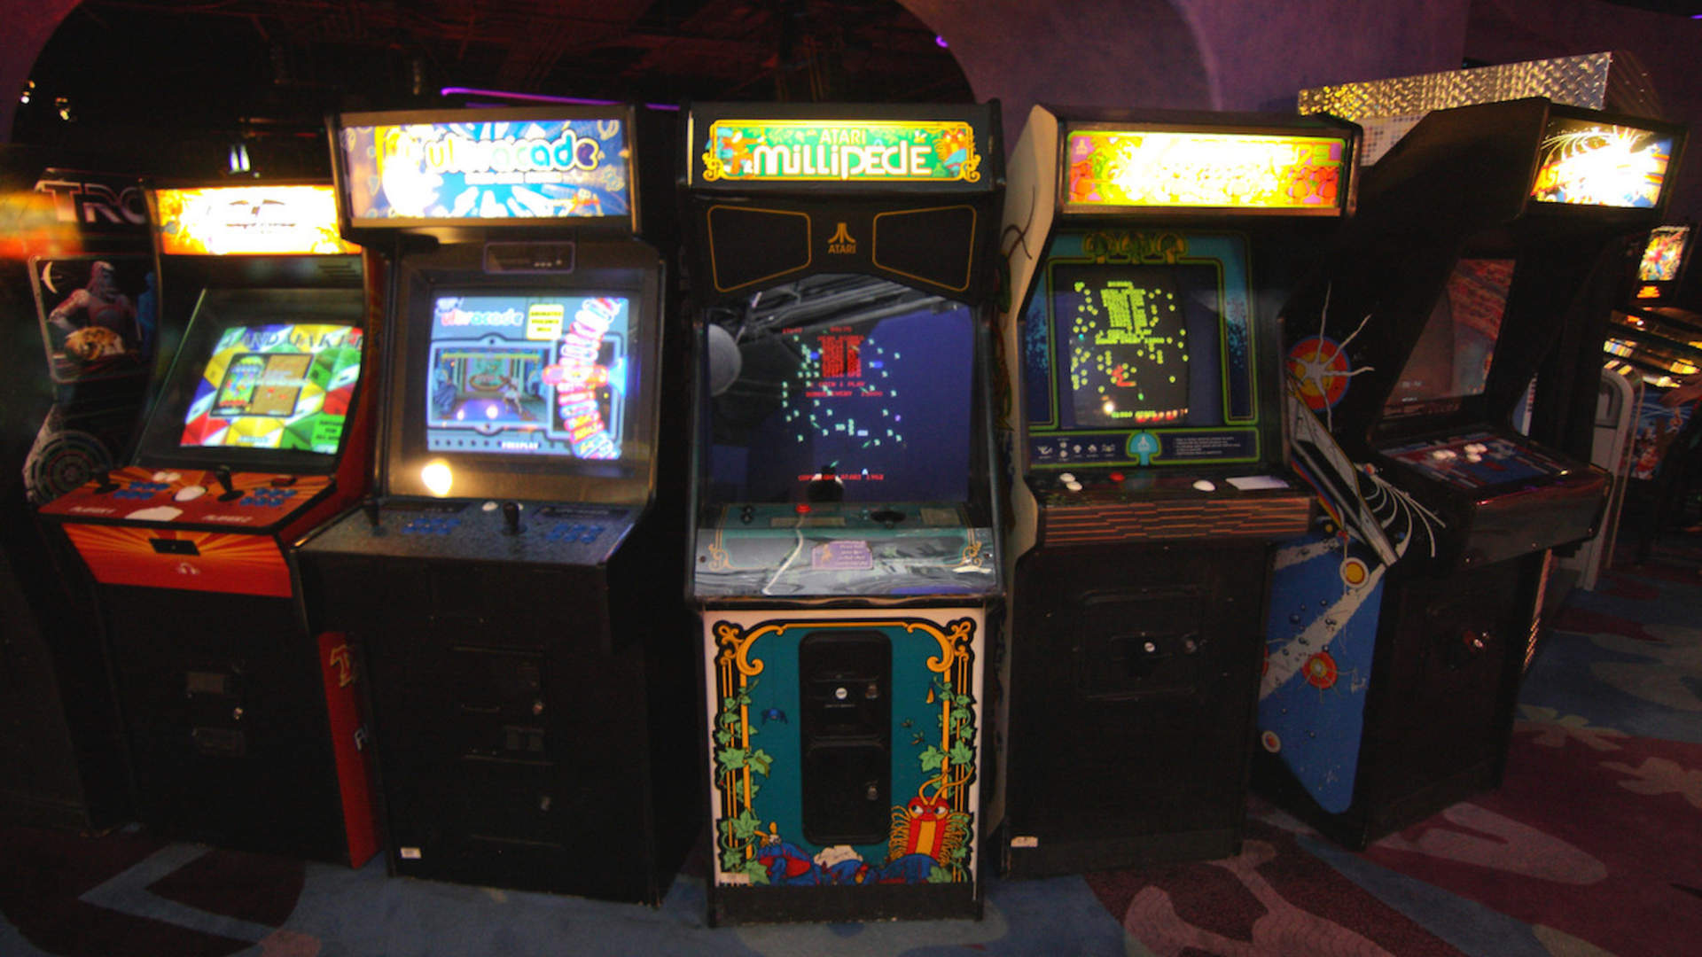
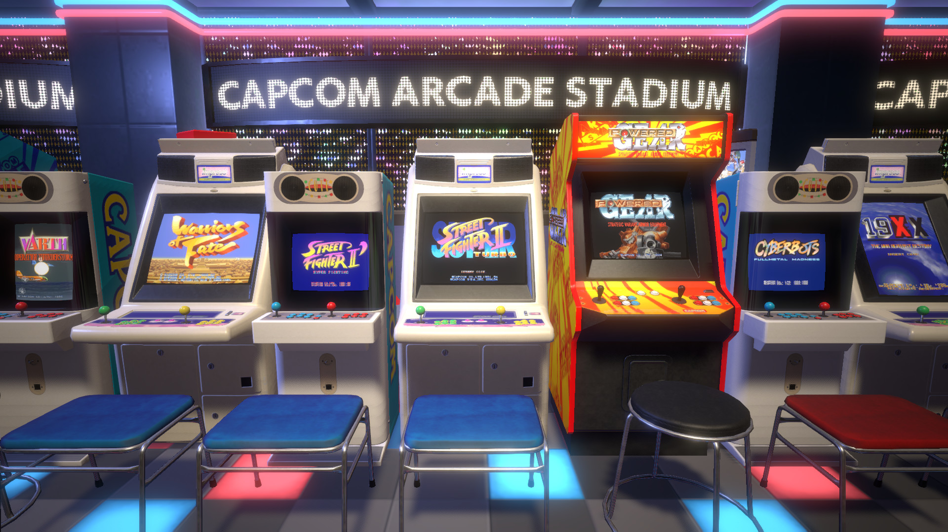
Metaverse concept implicitly began late 70’s.
a place to gather people & interactivity
To share common interests

Slide 9
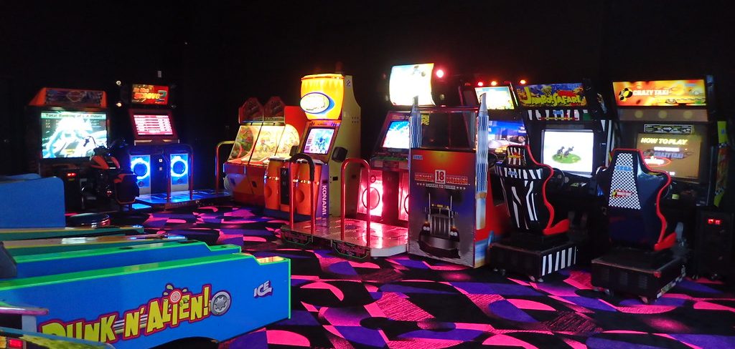
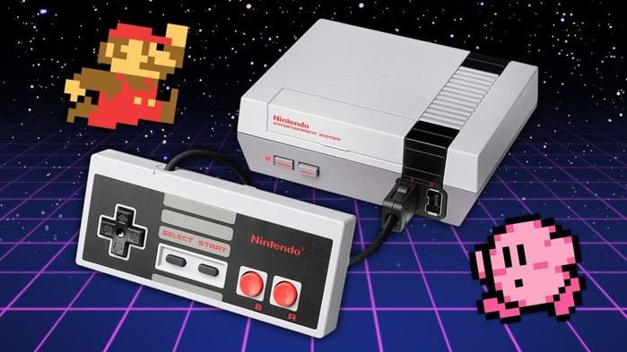

Flow of gaming/Simulation evolution (1)
This Photo by Unknown Author is licensed under CC BY-SA
This Photo by Unknown Author is licensed under CC BY-SA-NC
Arcade
Console
mobile
Entertainment
Entertainment
2D/3D gaming on a 2D screen to AR + Online social life by reading data
1978
1983
2007+

Slide 10

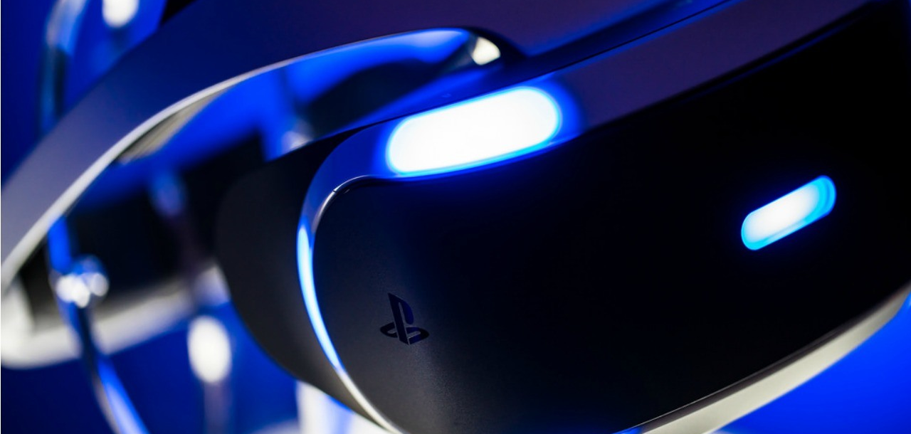

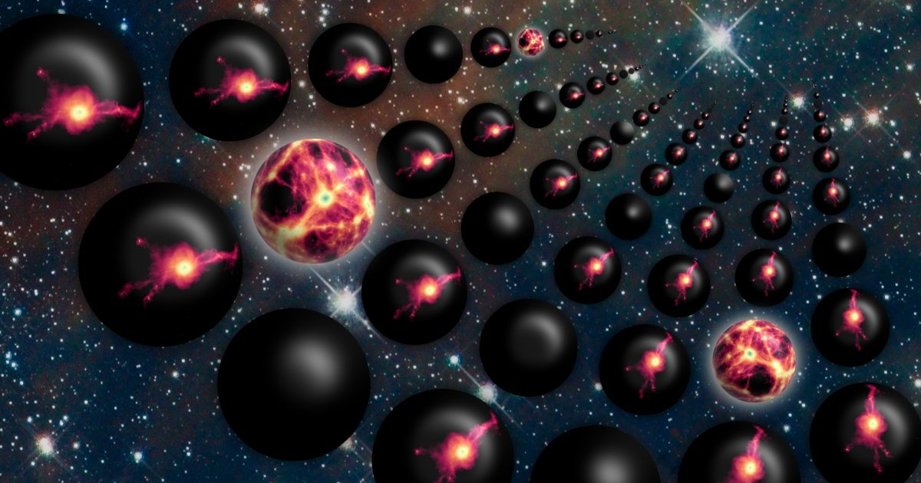
Flow of gaming/Simulation evolution (2)
This Photo by Unknown Author is licensed under CC BY-SA
This Photo by Unknown Author is licensed under CC BY
Virtual reality
metaverse
Multi-verse
Entertainment + Simulations of Healthcare & Sciences (STEM)
Second Life of everything, Inside Data
X Life Simulations, Dimensions, Origin
2019
2024+
????

Slide 11
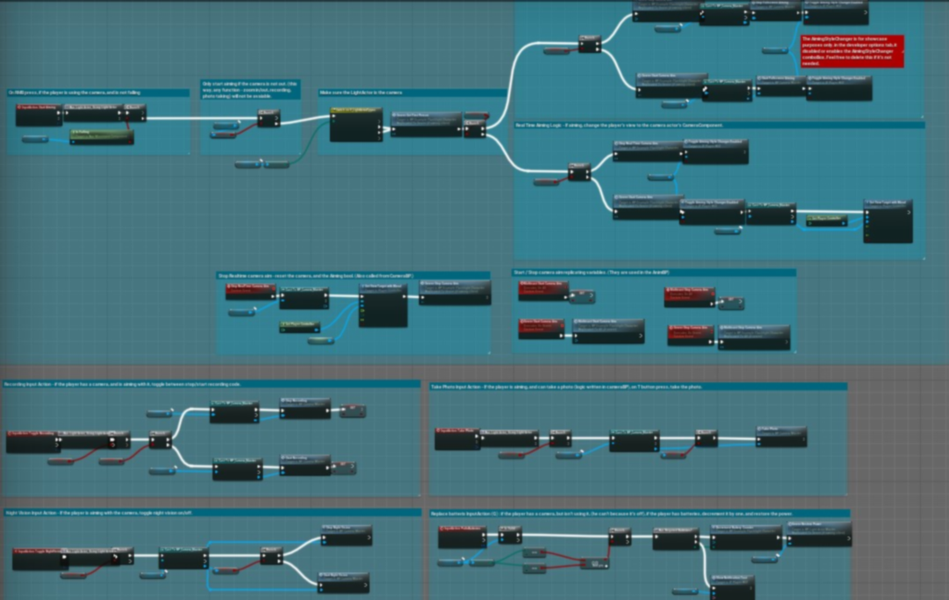
Programming behind everything
Gameplay Mechanics
"I trust code more than people anyway."
—Elsie Hughes, Westworld, S02 episode four
The world as numbers

Slide 12
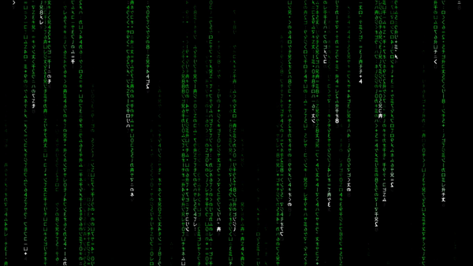


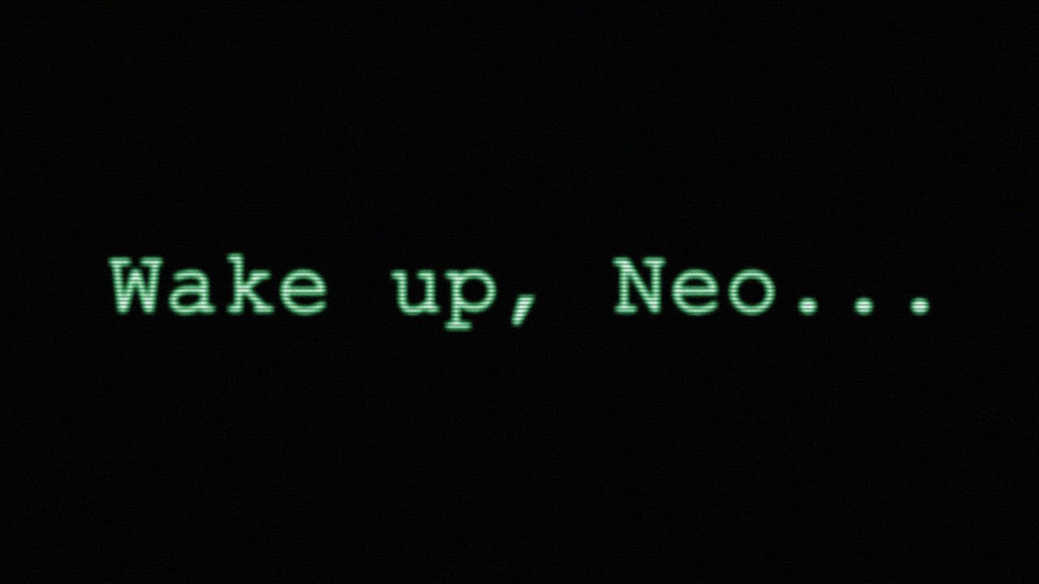
02
Major requirements
You can enter a subtitle here if you need it

Slide 14


Gameplay mechanics
4
0
Progress
Notes:
Insert a horror after the main feature showcase with assets freaks of horror place and jumpscare with flare after run out of flashlight

Slide 15
Enter The
6
0
Matrix
A glimpse of the future
NEAR

Slide 17
Horror
Horror
Horror
Horror
Notes:
Test Slide A:\Documents2\Clips\first_vid_list\horrorword\new_test_succeed\final

